Slide 1
Inventory Management System

Slide 2

About me
Name : Harjeevan Jagpal
Age : 24
Place of Birth : Wolverhampton
University : Manchester Metropolitan University
Degree : Computer Science
Learning Disability : Dyslexic
Things about me :
Started off with a Btec in Games Development
Computer Science – 2:1
Now at QA Consulting
Hobbies:
Football
Music
Photography (Most recent)

Slide 3
Specification

Slide 4
Introduction
I am required to design and create an application using the Programming fundamentals module, this will be able to interact with a managed database.
The objective of this project is to create an application with utilisation of supporting tools, methodologies and technologies that encapsulate all fundamental modules covered during the training.

Slide 5
What is included.
To create my project, I needed to use CRUD :
CREATE
READ
UPDATE
DELETE
This will allows me to add, update, delete and also read customers and items within the tables inside my tables.

Slide 6
Analysis & Design

Slide 7
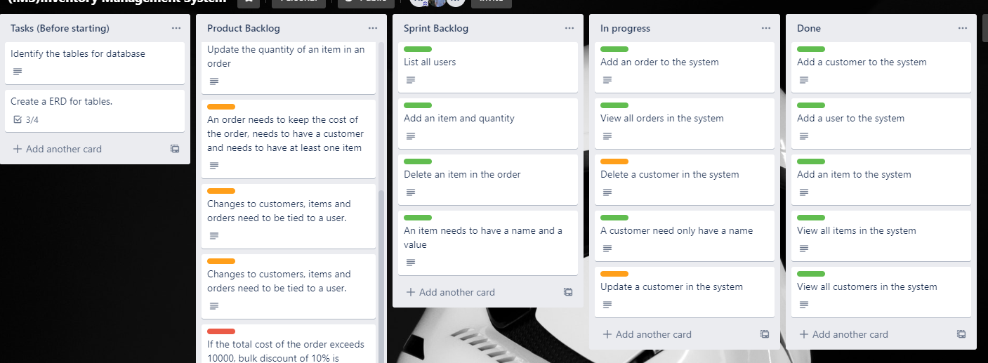
Trello

Slide 8
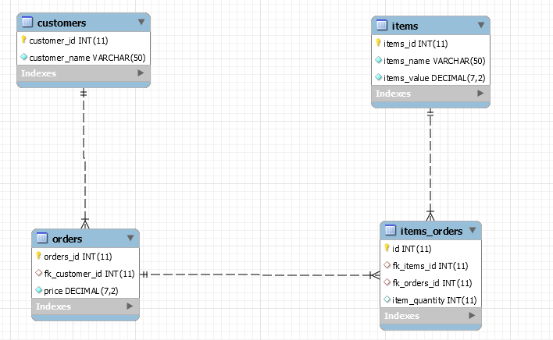
ERD – Entity Relationship Diagram

Slide 9
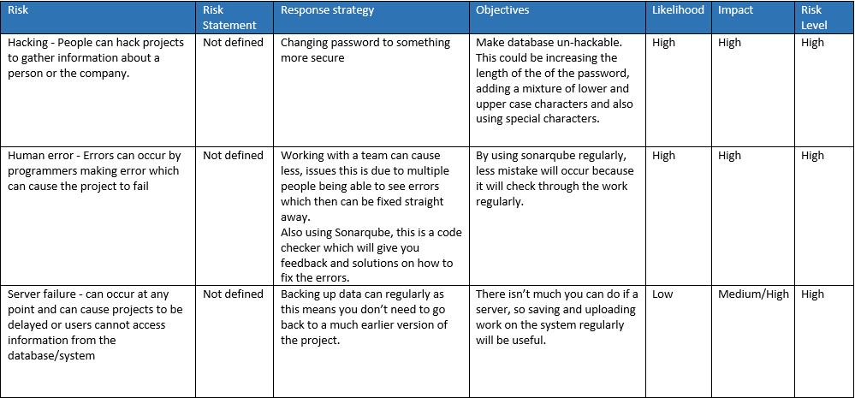
Risk assessment

Slide 10
Coding

Slide 11
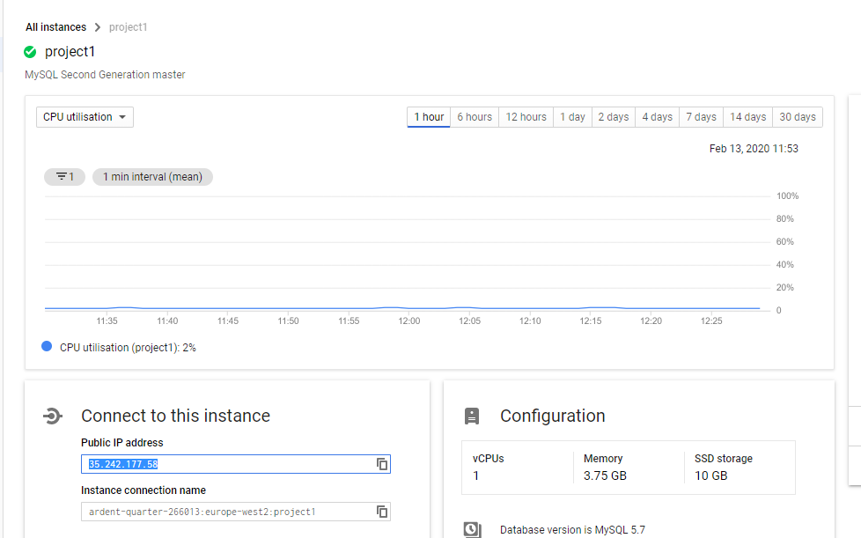
Google Cloud Platform → MySQL
The screenshot is the GCP, this is how we are connecting our database and java project. The IP is entered into the hostname in MySQL workbench and the DOA in the application.

Slide 12
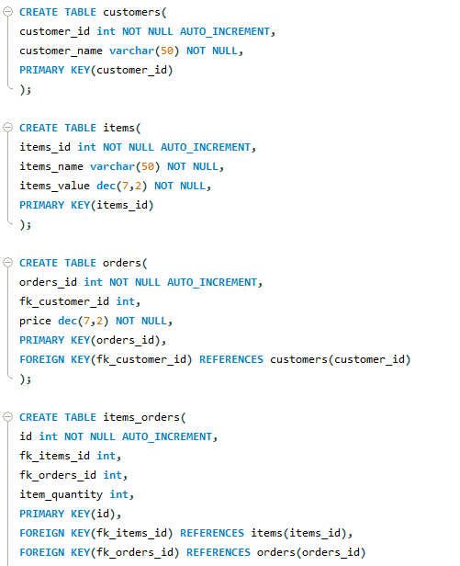
Database – MySQL Workbench
By using MySQL workbench, I was able to create my database.
Within the database I was able to create tables, there are 4 tables (Customers, Items, Orders and Items_Orders)
Each table will have 1 primary key, which is auto incremented and the table headings.

Slide 13
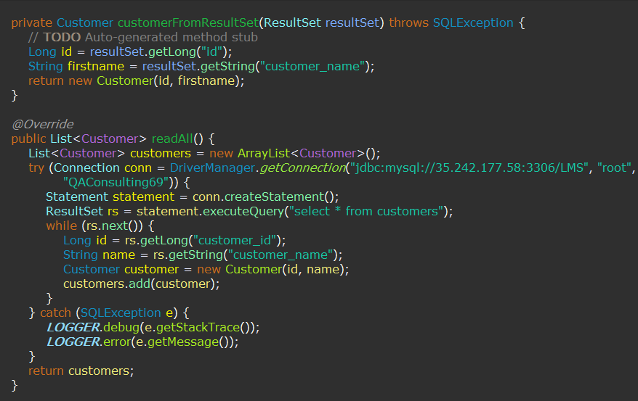
JAVA -Eclipse
We used Eclipse to create the project, the image on the left is code from my project.
By having a DAO, I was able map my application which calls to the persistence layer, the DAO provides some specific data operations without exposing details of the database.

Slide 14
Testing

Slide 15
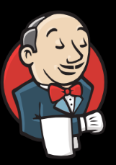
Jenkins
Jenkins is an open source automation tool written with plugins.
Jenkins is used to build and test software projects continuously making it easier for developers to integrate changes.

Slide 16
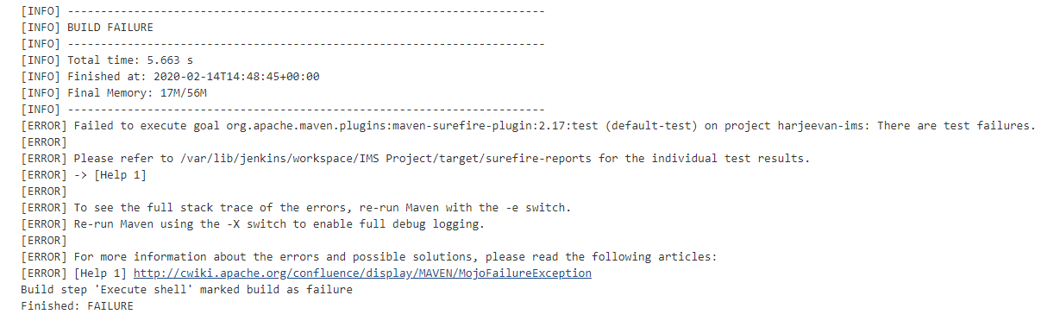
Jenkins

Slide 17

Sonarqube
Is an open source tool suite which will measure and analyse the quality of the code in your project.
It is written in Java and it is able to analyse code in different languages.

Slide 18
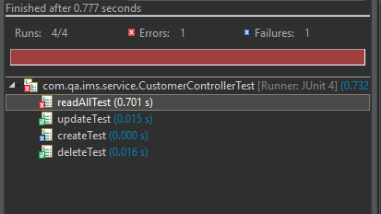
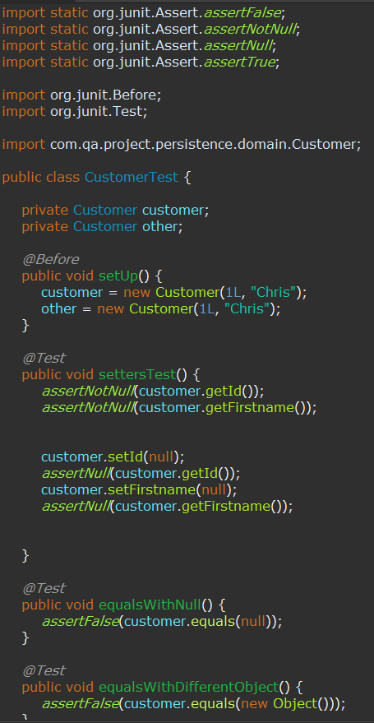
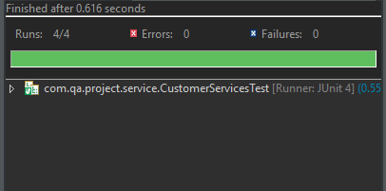
JUnit testing

Slide 19
Future development

Slide 20
What’s next for my project
The next step for this project is to add Orders and Items_Orders, this will allows users to check for orders which customers has ordered.
There is further development after this, for example adding a GUI (Graphical User Interface), this will make it more appealing to add information into the database but also to when receiving data, it can be easier to read.
Continue to test my project by using Jenkins and Sonarqube.
Testing all function and methods

Slide 21
Thanks for listening
Is there any questions?

